Slide 1

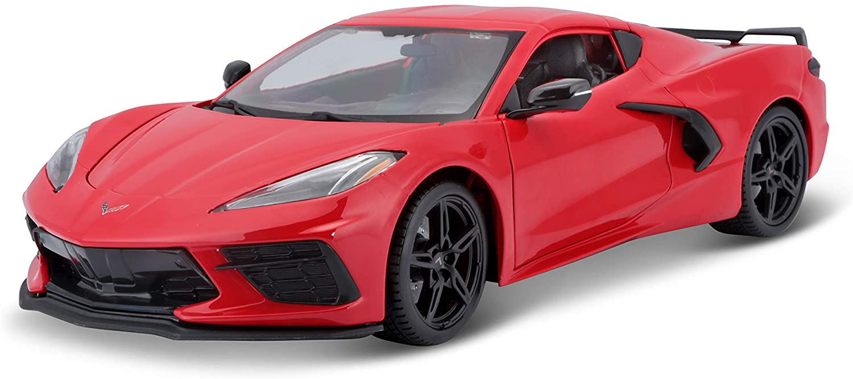
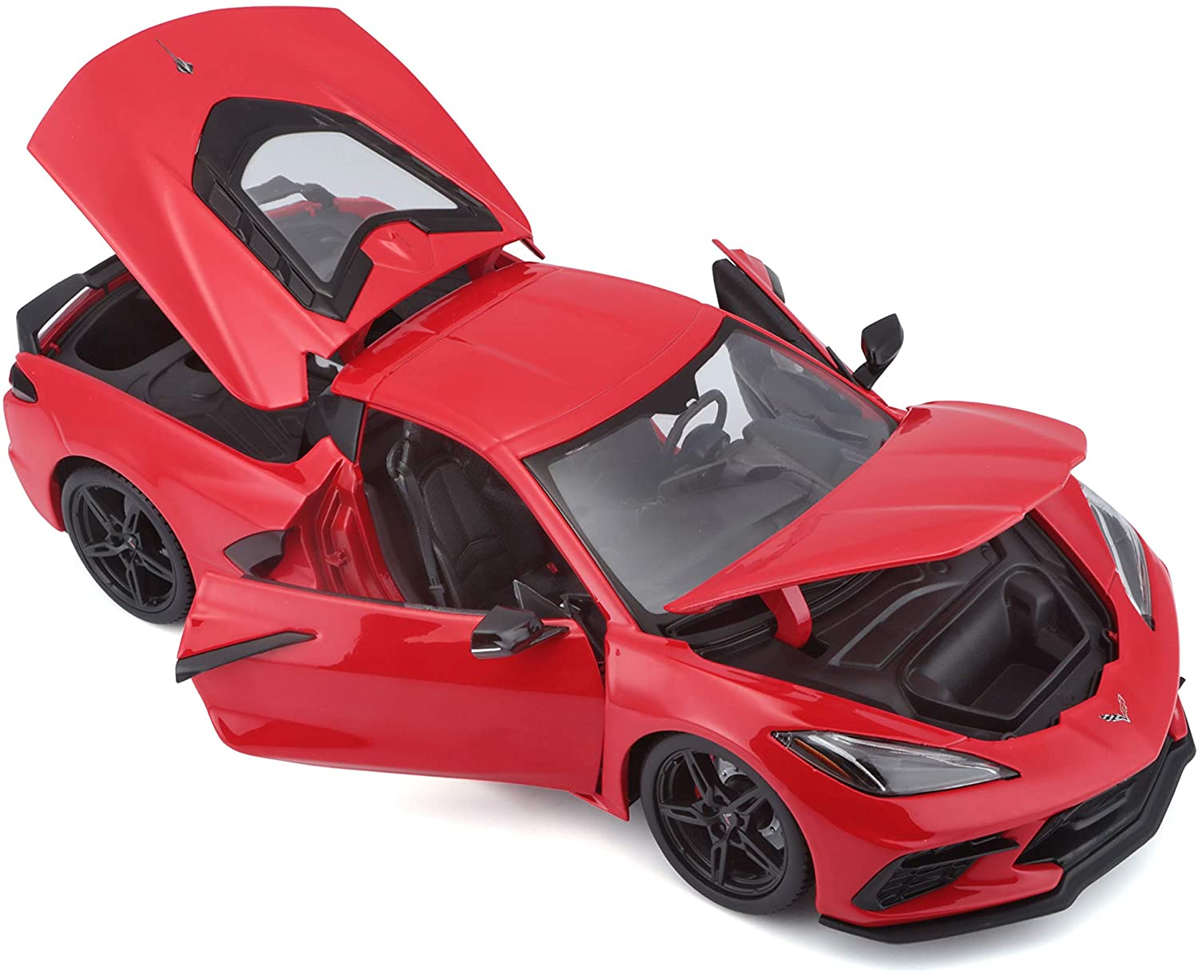
Corvette Price Tracker
A price tracker used to track the price of a corvette
By:
Shane Staber

